Slide 1

Covid-19 Project Presentation

Slide 2

Team Members
Anshika Singh
Vicky Khobragade
S James
Regu Nagaraju

Slide 3

Index
State wise recovery rate
Top 10 vaccinated states
Delta7 state-wise confirmed cases
Delta7 state-wise vaccination
Month-wise total confirmed cases
Category-wise count of District
Top 10 severe states
Top 10 states having highest death cases
Bottom 10 states having least death cases
Confirmed cases in a state by month
Weekly evolution of number of confirmed cases, recovered cases, deaths, tests for states.

Slide 4


Slide 5
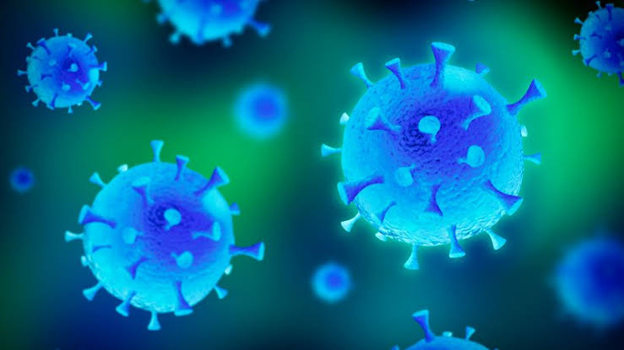
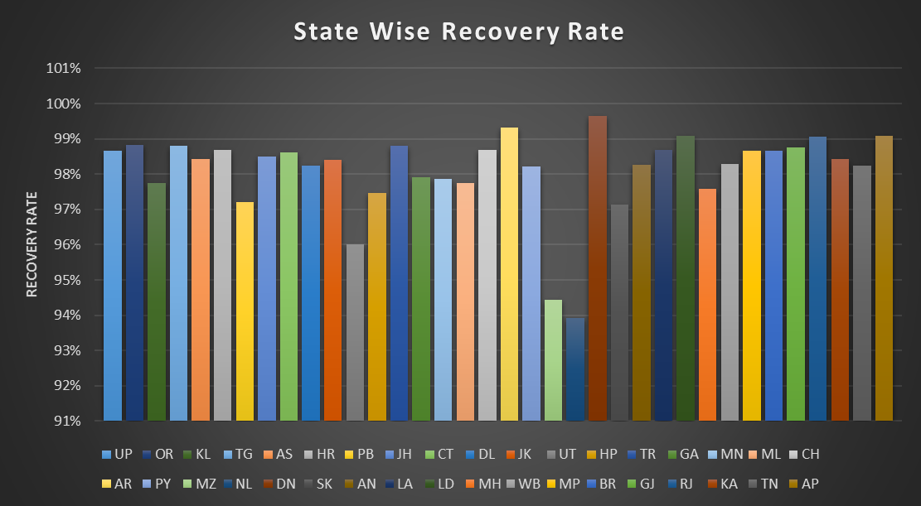
Dehradun has shown maximum recovery rate

Slide 6

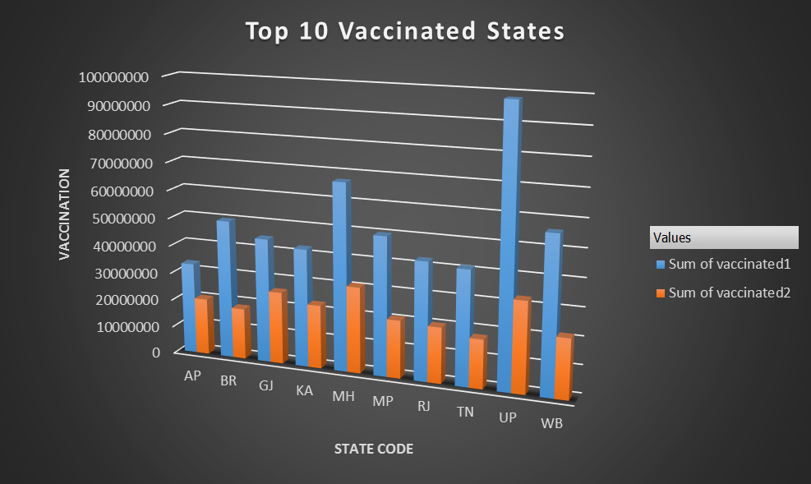
UP is the most vaccinated state

Slide 7
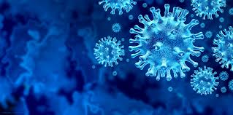
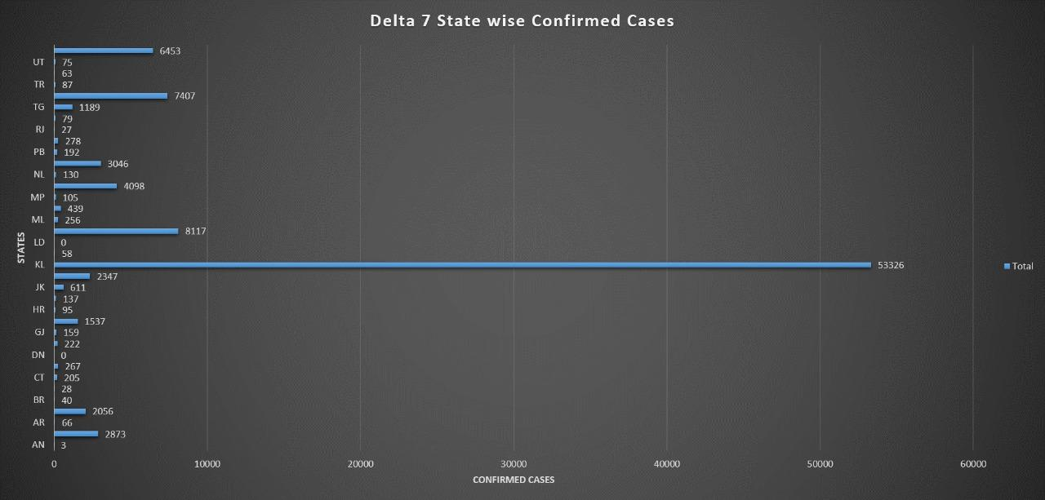
Kerala is the state with most Delta7 confirmed cases

Slide 8
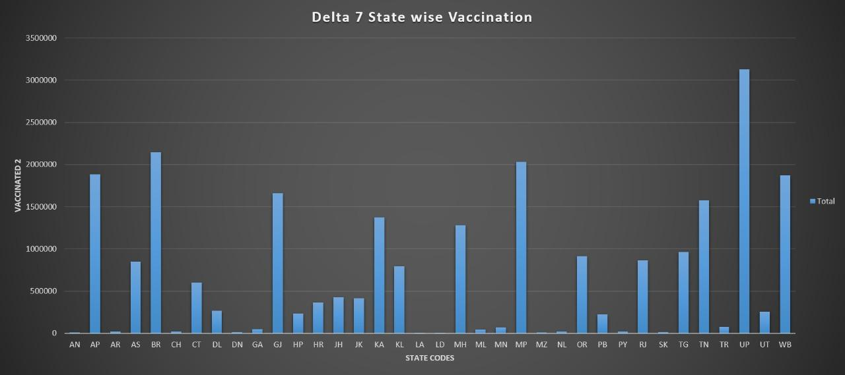
UP had highest vaccination for Delta7 variant

Slide 9
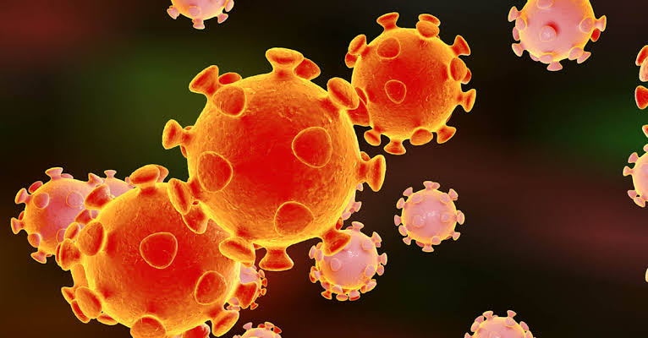
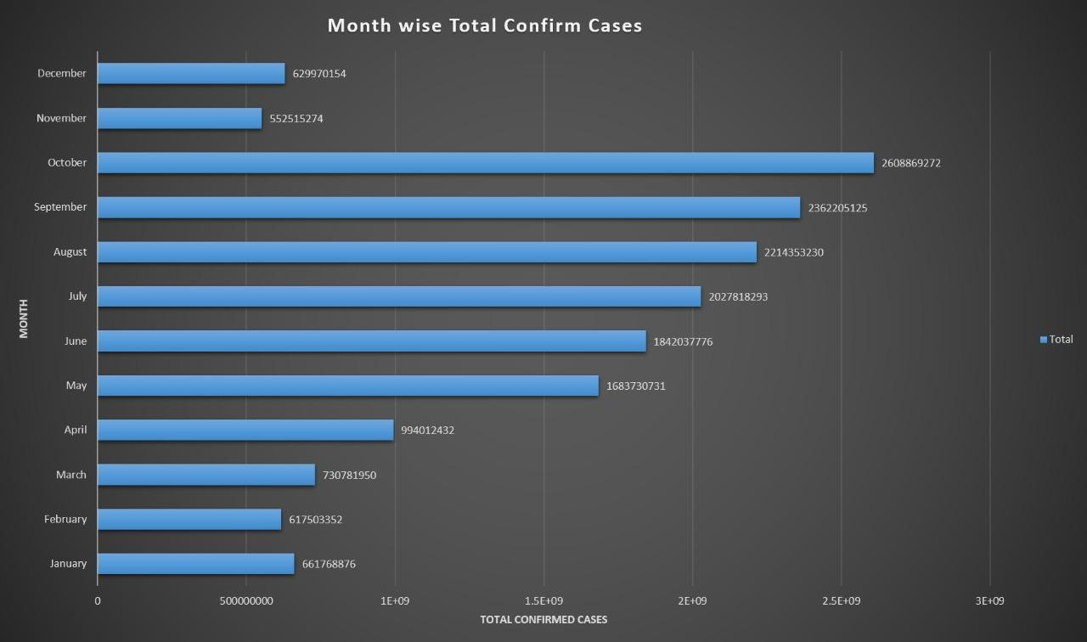
Oct is the most severe month in terms of confirmed cases

Slide 10
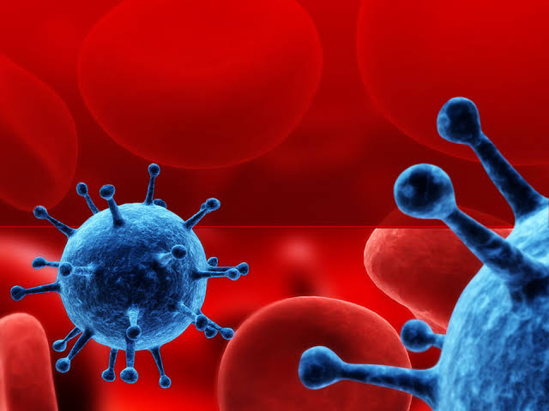
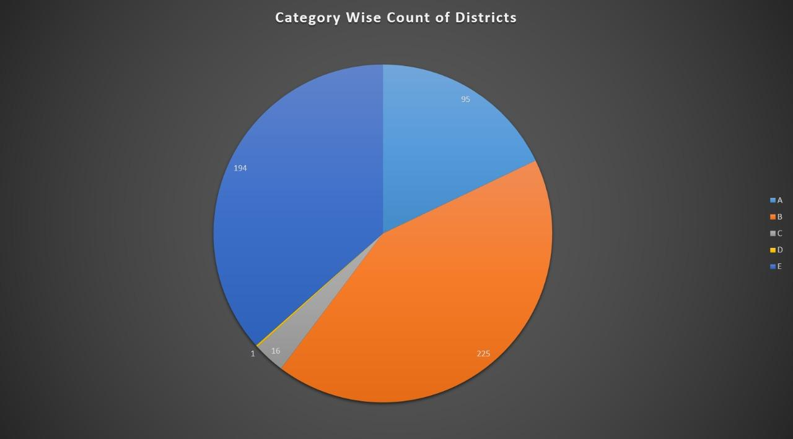
Testing Ratio = No. of Tests/ Population
Category A: 0.05 ≤ tr ≤ 0.1
Category B: 0.1 < tr ≤ 0.3
Category C: 0.3 < tr ≤ 0.5
Category D: 0.5 < tr ≤ 0.75
Category E: 0.75 < tr ≤ 1.0
Category A: 95 Districts
Category B:225 Districts
Category C:16 Districts
Category D: 1 Districts
Category E: 194 Districts

Slide 11

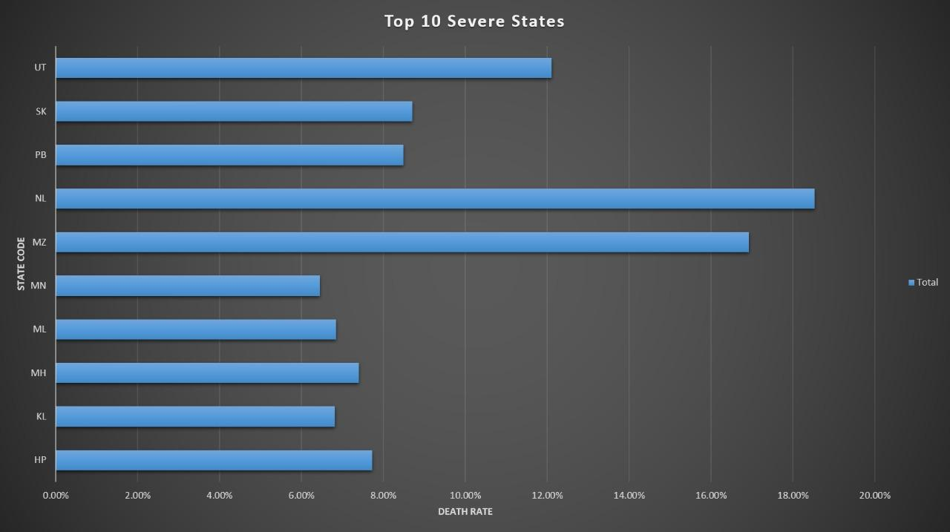
Death rate is highest in Nagaland

Slide 12
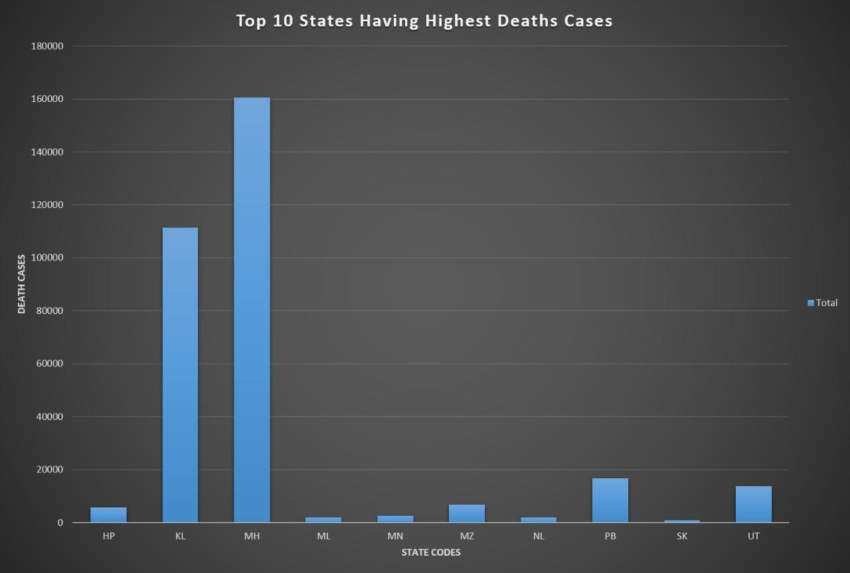
Maharashtra has the most number of death cases

Slide 13
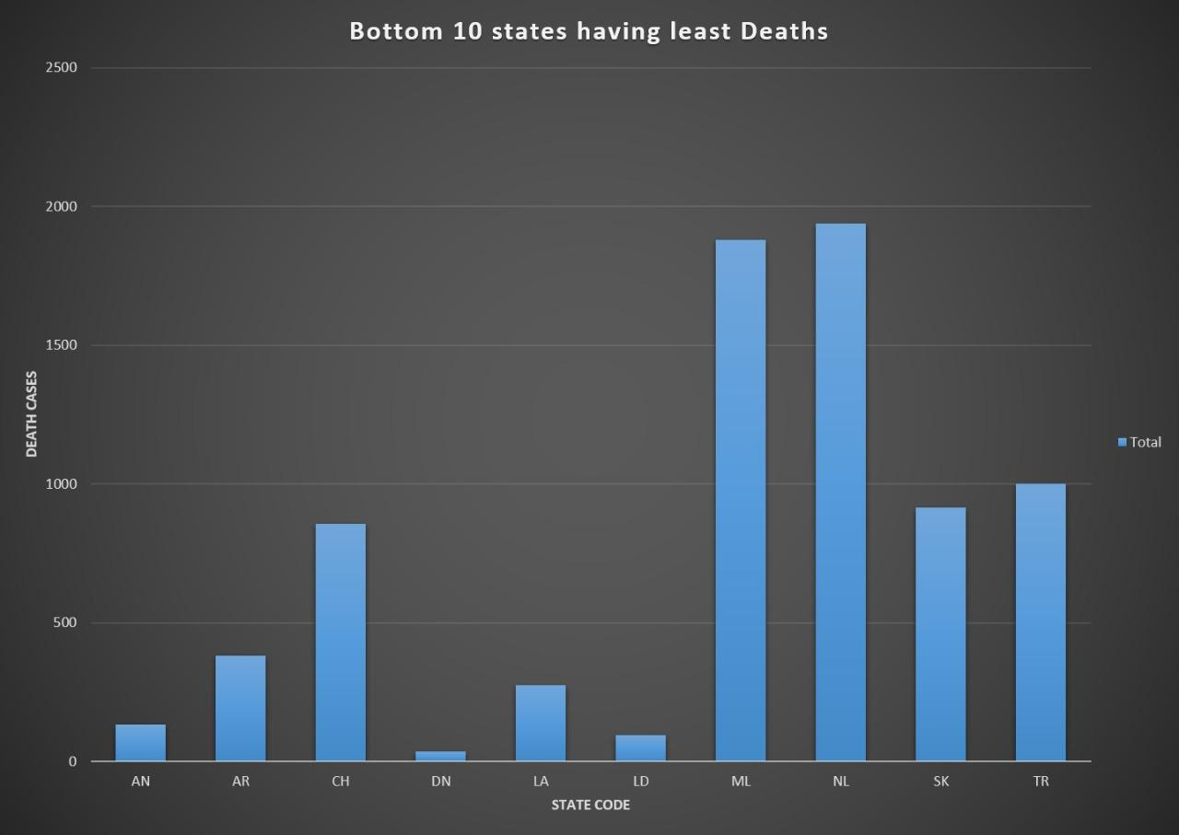
Dehradun has least number of death cases

Slide 14
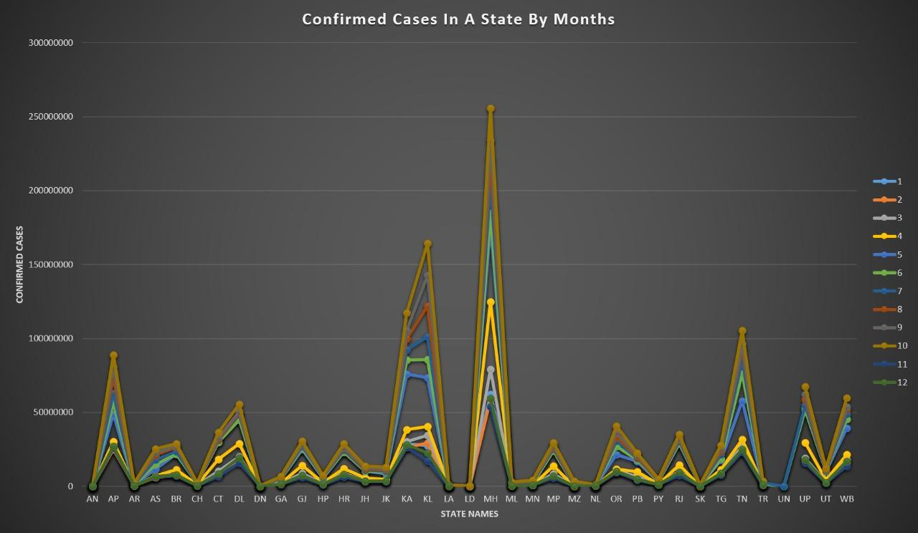

Slide 15
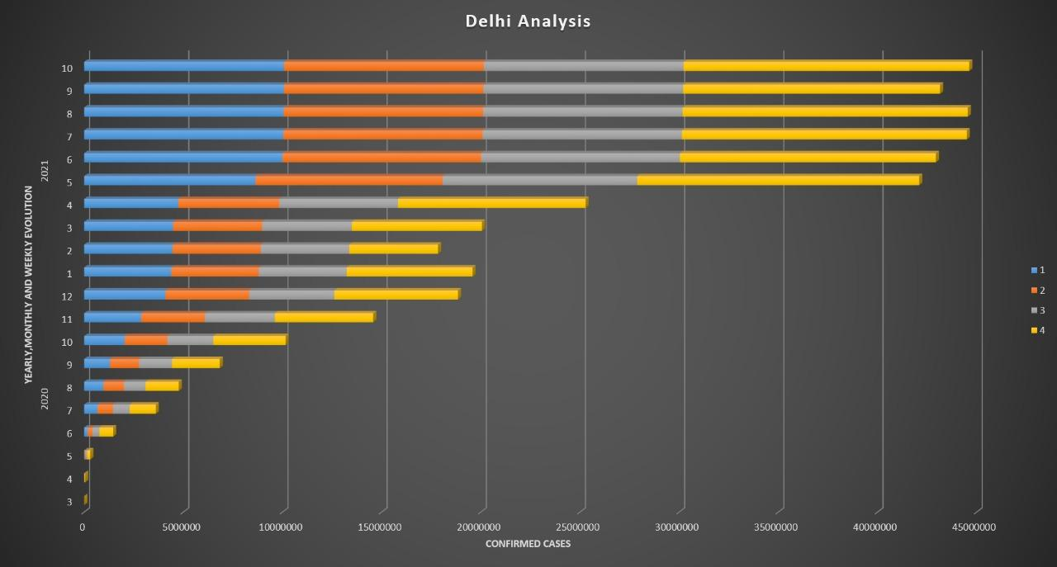

Slide 16
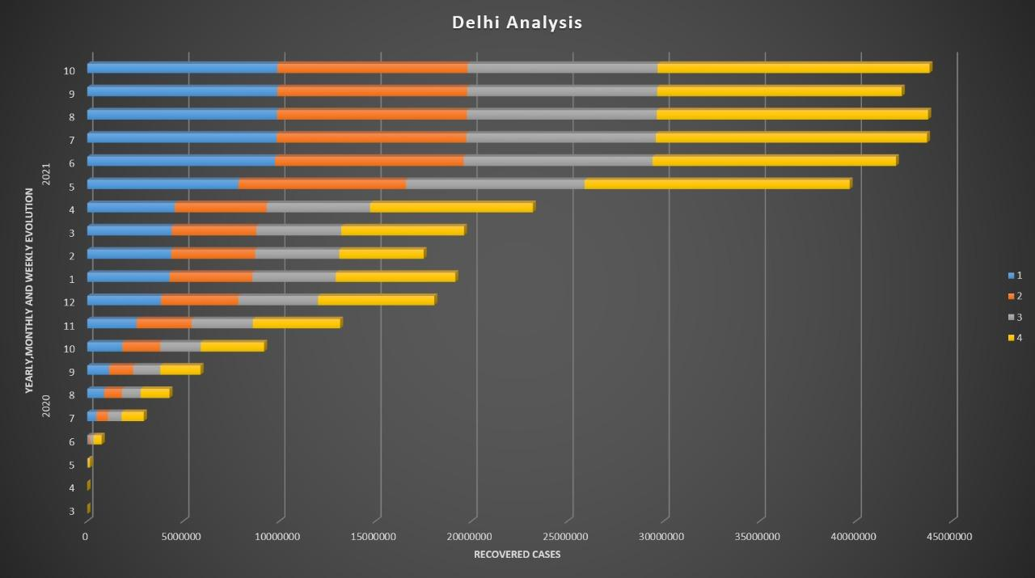

Slide 17
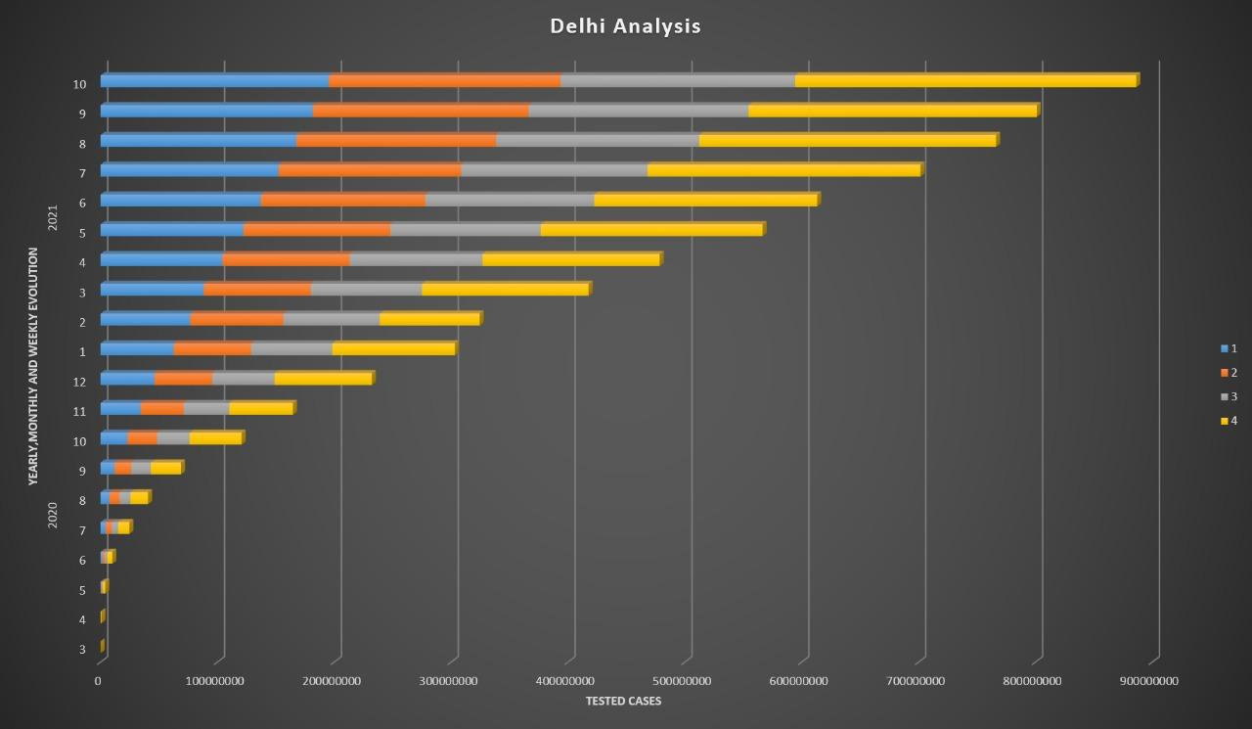

Slide 18
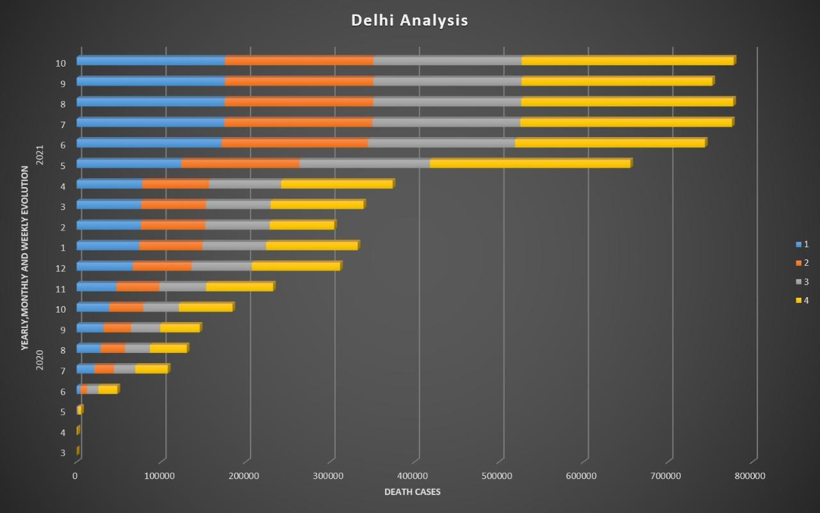

Slide 19

Python
Excel and PowerPoint
MySql

Slide 20
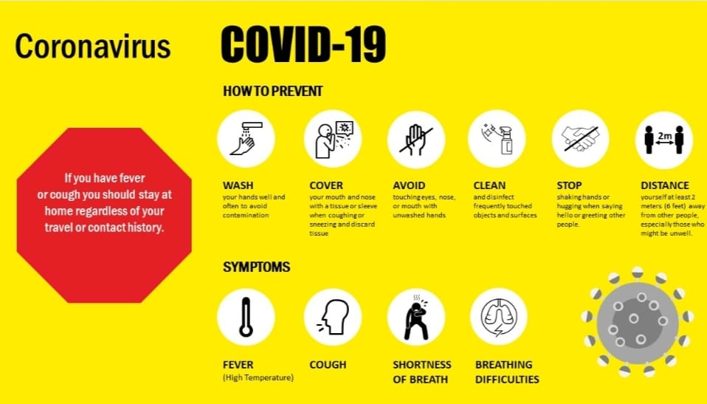

Slide 21


